Slide 1
EE205 Project 3: Yimacs Supplementary material
Hoyong Choi, WanJu Kang
hychoi@lanada.kaist.ac.kr
wjkang@lanada.kaist.ac.kr

Slide 2
Dictionary
A dictionary is a general-purpose data structure for storing a group of objects.
A dictionary has a set of keys and each key has a single associated value.
When presented with a key, the dictionary will return the associated value.
Keys in a dictionary must be unique

Slide 3
AVL tree based-dictionary for Yimacs
Key: a word
Value: a linked list containing line numbers where the word occurs
Words are sorted in alphabetical order (or more precisely, by string::compare() method)
key
value
Flavor
3
12
24
Cookie
6
Red
5
27
36
Bad
Dumb
Power
Rookie
25
46
3
11
30
10
11
42
53

Slide 4
RB tree based-dictionary for Yimacs
Key: a word
Value: a linked list containing line numbers where the word occurs
Words are sorted in alphabetical order (or more precisely, by string::compare() method)
key
value
Flavor
3
12
24
Cookie
6
Red
5
27
36
Bad
Dumb
Power
Rookie
25
46
3
11
30
10
11
42
53

Slide 5
How to store a text file
Text file
Linked list of strings
Until the day when the East Sea's waters and
Mt. Baekdu are dry and worn away,
God protect and preserve us.
Long live our nation!
Three thousand Li of splendid rivers and mountains,
filled with Roses of Sharon;
Great Korean People,
stay true to the Great Korean way.
The pine tree atop foremountain
stands firmly unchanged under wind
and frost as if wrapped in armour,
as is our resilient spirit.
Three thousand Li of splendid rivers and mountains,
filled with Roses of Sharon;
Great Korean People,
stay true to the Great Korean way.
Until the day when the East Sea's waters and
Mt. Baekdu are dry and worn away,
God protect and preserve us.
Long live our nation!
Three thousand Li of splendid rivers and mountains,
…

Slide 6
How to search and replace words
Input phase
You read the input file line by line, and store lines in a linked list
While doing that, insert each word in a line into a AVL(RB) tree, and store the line number in the linked list in the corresponding node
Search and replace phase
First, you search the target word in the AVL(RB) tree
Find line numbers where the target word occurs by iterating through the corresponding linked list
While iterating, replace the target word in the linked list storing the text.
Output phase
Save all lines in the output file by iterating through the linked list storing the text

Slide 7
AVLNode and AVLTree class
Based on the lecture note
The root node’s parent is NULL
An external node is a node with the key of an empty string (“”) and NULL children

Slide 8
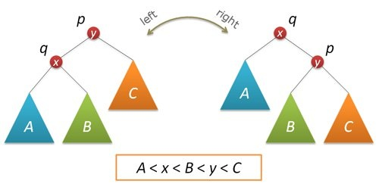
Balancing in AVL trees
Right rotation on node p(left side) returns node q(right side) after the rotation.
Left rotation on node q(right side) returns node p(left side) after the rotation.

Slide 9
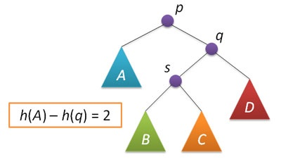
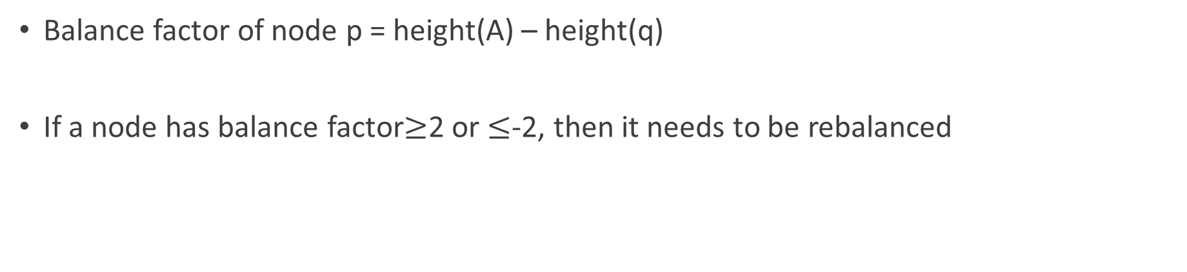
Balancing in AVL trees (cont’d)
※ The notation here is a bit abused.
The input of height() function
should be a node, not a tree.
Balance factor of node p = height(A) – height(q)
If a node has balance factor$≥$2 or $≤$-2, then it needs to be rebalanced

Slide 10
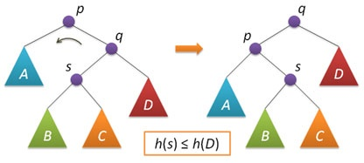

Balancing in AVL trees (cont’d)
If balance factor of node p is -2
Case 1: height(s)$≤$height(D)
A single left rotation on node p is enough.
After the rotation, you may have to rebalance on q’s parent.

Slide 11
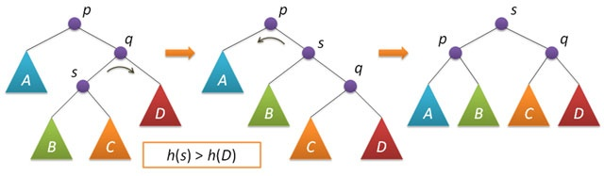

Balancing in AVL trees (cont’d)
If balance factor of node p is -2
Case 2: height(s)$>$height(D)
Double rotation is required as the figure above.
After the rotation, you may have to rebalance on s’ parent.
You have 2 more cases to cover
→What If balance factor of node p is 2?

Slide 12
RBNode and RBTree class
Also based on the lecture note
The root node’s parent is NULL
An external node is a node with the key of an empty string (“”) and NULL children

Slide 13
Keeping properties in RB trees
Root Property: the root is black
External Property: every leaf is black
Internal Property: the children of a red node are black (red rule)
Depth Property: all the leaves have the same black depth (path rule)
Problem Cases
Insert case → Insert node (It is all red) → Double Red (Violate Internal Property)
Delete case → Delete black node → Double Black (Violate Depth Property)

Slide 14
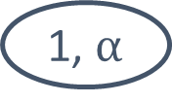
Insert Case (Double Red)
Case 1 (If uncle is black)
2
2, 3, 4
Uncle
2-4 Tree
1
4
1, $α$
Problem
3
. . .
Black node and their children red node become one node
3
“Restructuring”
2
4
1

Slide 15
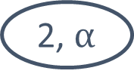
Insert Case (Double Red)
Case 1 (If uncle is red)
2, $α$
Split the node freely
2
1, 2, 3, 4
. . .
1
3, 4
Uncle
2-4 Tree
1
4
Problem
3
Black node and their children red node become one node
2
“Recoloring”
1
4
3
You have delete case to cover
→Let’s consider a similar idea using 2-4 Tree.

Slide 16
C++ template function/class
Templates allow us to create a function/class template whose functionality can be adapted to more than one type or class without repeating the entire code for each type
Since we are using your own linked list implementation in AVLTree class and RBTree class, that part is abstracted by using templates
In avl_tree.cpp, you have to include your linked list header (e.g., linked_list.h) and instantiate AVLTree class (e.g., template class AVLTree<Your_linkedlist_class>;)
In rb_tree.cpp, you have to include your linked list header (e.g., linked_list.h) and instantiate RBTree class (e.g., template class RBTree<Your_linkedlist_class>;)
More information can be found on http://www.cplusplus.com/doc/oldtutorial/templates/

Slide 17
Tips
Study AVL, RB tree thoroughly before you start!
AVLNode, RBNode class stores a pointer to the parent node. This is nothing but a design choice, as it is not necessary. But it might ease your implementation. When you change a parent-child relation, don’t forget to make changes on both sides; you should change the child pointer in the parent node, and the parent pointer in the child node.
The Internet is there for you. If you have an error, do not hesitate to google it.
Make sure your implementation covers all corner cases, as they will be tested when grading.
Be careful of memory leak
START EARLY!

